Slide 1
Smith v. City of Westfield SJC-12243
Seth Schofield
Senior Appellate Counsel
Assistant Attorney General
Energy and Environment Bureau
seth.schofield@state.ma.us
(617) 963-2436

Slide 2
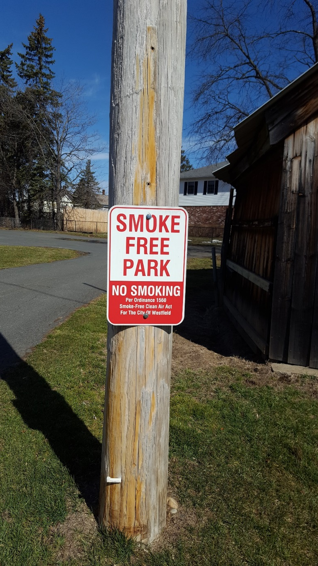
The Park at Issue

Slide 3
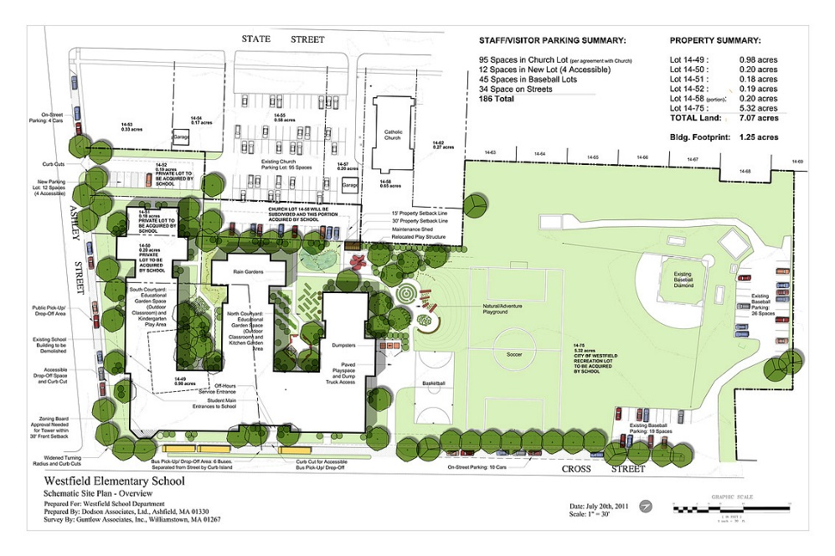
The Elementary School Project
The City of Westfield proposed to construct a new elementary school on 1.35 acres of the 5.3 acre park that would serve 600 students.

Slide 4
The Park Today

Slide 5
The Park Today

Slide 6
Involvement of the Attorney General’s Office (AGO)
2013 – AGO alerted Plaintiffs’ counsel that there was no role for AG at time given preliminary injunction and Mass. School Building Authority assurance to withhold funds pending outcome of the lawsuit.
2016 – Plaintiffs’ counsel alerted us to Appeals Court decision and the plaintiffs’ intention to seek further appellate review.
2016 – AGO submits a letter urging the SJC to accept the case for further appellate review.
2017 – AGO submits an amicus brief urging the SJC to reverse the Appeals Court’s decision.
2017 – SJC grants the AGO’s motion to participate in oral argument.

Slide 7
Judicial Erosion of Article 97
Selectman of Hanson v. Lindsay, 444 Mass. 502 (2005)
Mahajan v. Department of Environmental Protection, 464 Mass. 604 (2013)
Smith v. City of Westfield, 90 Mass. App. Ct. 80 (2016)
*Quinn Opinion, Rep. A.G., Pub. Doc. No. 12 (1973)

Slide 8
Restoring Article 97
Historical research on Article 97 and pre-Article 97 case law
Reconnect Article 97 to its historical roots: the prior public use doctrine
Re-establish legal test for determining when land has been dedicated to a protected public use
Reinforce Article 97 with discussion of implications of a recording-only rule and the myriad environmental and public benefits of parks and conservation land
Provide a roadmap for the Court to navigate between its prior precedents

Slide 9
AG Arguments
The overriding inquiry is whether the government unequivocally intended to set aside land for an Article 97 purpose.
There is no evidence that suggests that Article 97 was intended to reduce protection for park and conservation land
Article 97 increased the well-established common law protection for park and conservation lands by changing the simple majority vote to an on the record super majority vote and elevating it to constitutional stature.

Slide 10
AG Arguments
Article 97 made no other changes to the common law
The prior common dedication law cases still govern the question whether land has been designated for a protected Article 97 purpose
Those longstanding common law cases make clear that a deed or other recording is not necessary to designate land for a particular public purpose, including an Article 97 purpose

Slide 11
SJC Decision – Oct. 2, 2017
The Court reverses, and holds that the park had been dedicated as a public park, subject to Art. 97’s protection
Court makes clear the importance of parkland to the general public.
Article 97 “must be understood in” the context of the common law that pre-dated it.
“There is no reason to believe that art. 97 was intended . . . to diminish” protection afforded by the common law.

Slide 12
SJC Decision – Oct. 2, 2017
“land is dedicated to the public as a public park when the landowner's intent to do so is clear and unequivocal, and when the public accepts such use by actually using the land as a public park.”
Courts should look to the “totality of the circumstances” to determined whether land has been unequivocally dedicated for an Art. 97 purpose
Westfield park was so dedicated when the City accepted LWCF funds in 1979.

Slide 13
Special thanks:
Robert O’Conner, Director, Div. of Conservation Services, EEA
Melissa Cryan, EEA
Kurt Gaertner, EEA
Margaret Callanan, former Counsel EEA
Tom LaRosa, Chief Counsel, DCR
Rich Lehan, General Counsel, DFG
Alessandra Wingerter, AGO Intern/Land Ct. Clerk

