Slide 1
Bench trials
A view from . . . the bench
Hon. Michael D. Vhay, Massachusetts Land Court
January 18, 2018

Slide 2
Today’s agenda
Planning for Bench Trials, Start to Finish (or, the Finish is the Start)
Presenting the Case Persuasively: Direct Examination and Exhibits
Making the Case: Pre-Trial Briefs, Opening Statements and Closing Arguments
Questions and Comments

Slide 3
Some initial considerations
Trials – even bench trials – are serious matters.
When trying a real-estate case, trial-advocacy skills are as important as knowledge of real-estate law.
Good lawyers appreciate their limitations, and get help.

Slide 4
Planning for a bench trial

Slide 5
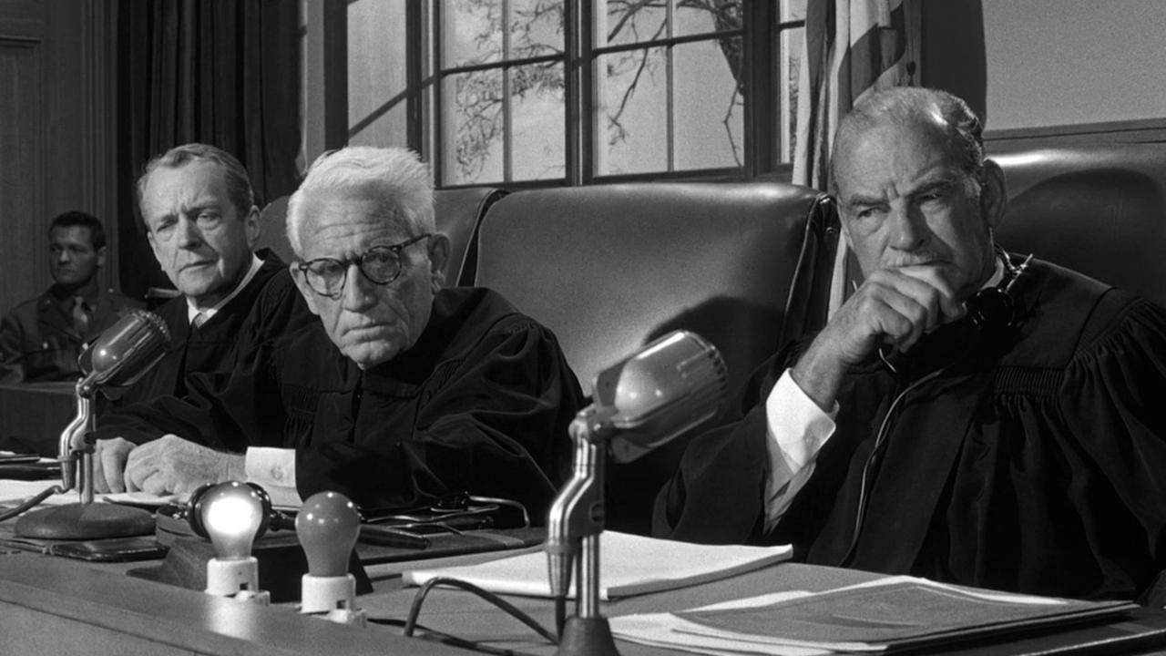
Famous bench trials

Slide 6
Stern & Salzburg, trying cases to win
Rules | Jury Trial | Bench Trial
Personal advocacy |  | 
Central theme |  | 
Case bigger than facts |  | 

Slide 7
Stern & Salzburg, trying cases to win
Laws | Jury Trial | Bench Trial
Primacy |  | 
Recency |  | 
Vividness |  | 
Frequency | 

Slide 8
essentials of trial advocacy
Reduce the case to a simple story
Match the story to the law (the theory of the case)
Develop the theme of the case
Work backwards from the desired result

Slide 9
The finish is the start
Remedy
Closing
Case in Chief
Cross-Examination
Re-evaluation
Opening

Slide 10
“pre-trial” trial advocacy
Develop a theory and a theme from the outset
Determine which issues aren’t (or shouldn’t be) disputed
Advance the theme in all filings (frequency)
Lay the foundation for an excellent trial relationship

Slide 11
“advice for going to trial”
Be prepared
Be orderly
Be brief
Be polite
Be congenial
Be civil
Be deferential
Avoid smugness
Be mindful of body language
Accept defeat graciously
Cecil C. Kuhne III, Convincing the Judge: Practical Advice for Litigators, 89-90 (ABA Publishing 2008)

Slide 12
Persuasive content
Direct examination

Slide 13
Aims of direct examination
Introducing undisputed facts (maybe)
Enhance the chances that the judge will decide disputed facts in your client’s favor
Lay foundation for disputed exhibits
Demonstrate that your client’s witnesses are credible
Hold the judge’s attention
Steven Lubet, Modern Trial Advocacy 15-17 (Nat’l Inst. for Trial Advocacy 1993)

Slide 14
Planning a direct examination
Content is the driver (see Aims of Direct Examination)
Corollary: Exclude
Clutter
The Unprovable
The Implausible
The Impeachable
Door-openers
Lubet, Modern Trial Advocacy at 20-23.

Slide 15
Organizing a direct examination
Start strong, end strong
Organize by topics (“Sub-Directs”), then by chronology
Start and end Sub-Directs strong
Get to the point
Give separate attention to important details
Don’t interrupt action
Unify circumstantial evidence
Affirmation before refutation
Be selective in raising defensive points
End with a clincher
Lubet, Modern Trial Advocacy at 24-33.

Slide 16
Presenting a direct examination
Engage the witness
Use short, open questions
DO NOT LEAD
Use directive and transitional questions (followed by short, open ones)
“Re-Initiate Primacy”
Use incremental questions
Repeat important points (with sensitivity)
Use visual aids (and rehearse)
Lubet, Modern Trial Advocacy at 33-43.

Slide 17
Persuasive content
exhibits

Slide 18
Real and demonstrative exhibits
advantages
disadvantages
Clear
Concrete
Understandable
Reliable
Few things speak for themselves
The “Safe Side” Problem
“Publication? We don’t need no stinking publication!”

Slide 19
Using exhibits persuasively
Be selective
Eye the design
Know the courtroom
Use in demonstrations
Use in cross-examination
Use in opening and closing
Draw attention to important provisions

Slide 20
Making the case

Slide 21
Pre-trial brief: the closing at the opening
Assume it’s your only shot
One Theory, One Theme
Be brief
Advocate credibly
Confine Findings of Fact to facts
Preview subsidiary facts

Slide 22
OPENING STATEMENT
Don’t forfeit
Expect it to be short
One Theory, One Theme
Order the facts as (you hope) the judge will
Interweave specific names, testimony, and exhibits

Slide 23
Closing argument
Understand, before trial:
Timing
Expected length
One Theory, One Theme
Start strong, end strong
Organize facts as a judge would analyze them
Be specific
Weave in circumstantial evidence
Marshal “incredibility” facts
Respond to (or anticipate) arguments that:
Undercut Theory and Theme
Derail the proposed analysis

Slide 24
Questions & comments

