Slide 1
LAWS GOVERNING APPLICATIONS FOR
WETLAND PERMITS & DETERMINATIONS
Luke H. Legere and Ryan D. Grondahl
March 9, 2023
www.mcgregorlaw.com

Slide 2
Massachusetts Wetlands Laws, Regulations, Policies
State Level
Wetlands Protection Act (“WPA”), M.G.L. ch. 131, § 40
Administered by: Conservation Commissions and Dept. of Environmental Protection (“MassDEP”)
Wetland Regulations (310 CMR 10.00)
Municipal Level
Wetlands Protection Bylaw or Ordinance
Administered by: Conservation Commissions
Wetland Rules & Regulations
Must be more stringent than WPA
Courts Interpret All!

Slide 3
Massachusetts Wetlands Laws, Regulations, Policies (Cont.)
The WPA and Bylaws/Ordinances give MassDEP and Conservation Commissions authority to enact regulations
Regulations:
Help carry out purpose of statute/bylaw/ordinance;
Provide more details on procedures + standards;
Provides clarification (if needed); and
Establishes specific requirements or performance standards
Regulations
Cannot exceed Statute/Bylaw/Ordinance
Enforceable
A Policy is not enforceable if not grounded in a Bylaw /Ordinance
Notes:
Regs – provide impt details to carry out purpose of law;
sometimes interpretations.

Slide 4
Conservation Commissions
Conservation Commissions were established by M.G.L. ch. 40, § 8C.
M.G.L. ch. 131, § 40 subsequently charged Conservation Commissions with local implementation of the WPA.
Conservation Commissions are also responsible for permitting under any local non-zoning wetlands bylaw or ordinance.
Hold quasi-judicial public hearings:
Adjudicatory in nature;
Schedule and continue hearings as Commission decides;
Make decisions based on document records at hearings.
All 351 cities and towns in Massachusetts have established Conservation Commissions with the power to regulate many activities in, near or affecting wetland resource areas.

Slide 5
Conservation Commission Duties
Massachusetts Wetlands Protection Act
M.G.L. c. 131, § 40
Local Wetlands Protection Bylaw or Ordinance
Wetlands Protection Regulations
310 CMR 10.00
Local
Wetlands Regulations
& Rules

Slide 6
Massachusetts Wetlands Protection Act
The WPA and its Regulations, 310 CMR 10.01(2), protect nine important “interests” associated with wetland “Resource Areas”.
Specifically, the WPA protects the following “interests”:
Private water supply;
Public water supply;
Groundwater supply;
Fisheries;
Prevention of pollution;
Protection of wildlife habitat;
Storm damage prevention;
Flood control; and
Land containing shellfish.

Slide 7
Massachusetts Wetlands Protection Act
M.G.L. ch. 131, § 40 provides that: “No person shall remove, fill, dredge or alter any bank, riverfront area, fresh water wetland, coastal wetland, beach, dune, flat, marsh, meadow or swamp bordering on the ocean or on any estuary, creek, river, stream, pond, or lake, or any land under said waters or any land subject to tidal action, coastal storm flowage, or flooding … .”
These protected areas are known as “Resource Areas” or “Areas Subject to Protection under M.G.L. ch. 131, § 40”.
Many Resource Areas also have a jurisdictional 100-foot “Buffer Zone” extending landward (or toward uplands) from their boundaries.

Slide 8
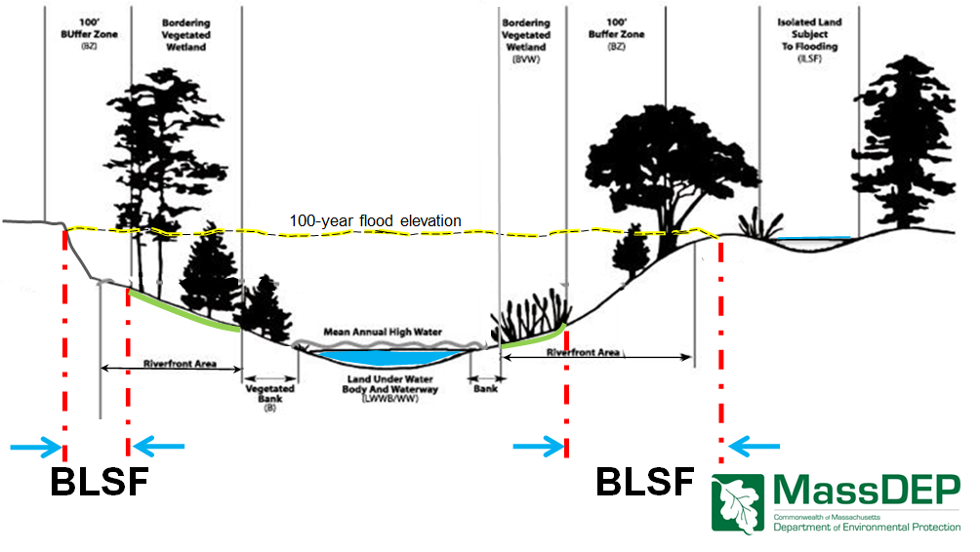
Wetlands Protection – What’s a Resource Area?
Inland
Resource Areas

Slide 9
Wetlands Protection – What’s a Resource Area?
Coastal
Resource Areas

Slide 10
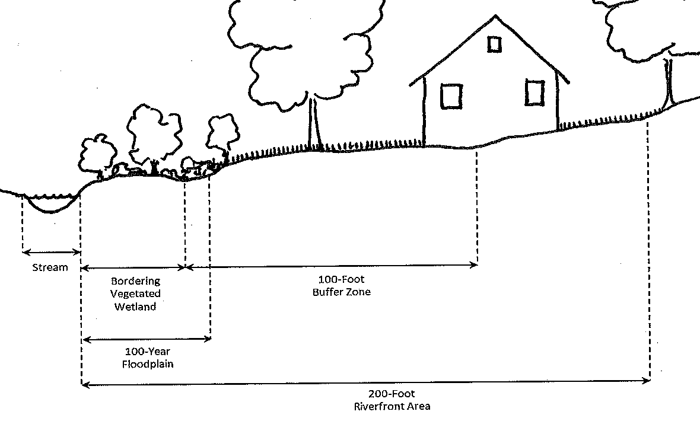
Wetlands Protection – What’s a Resource Area?
Wetland Resource Areas Can Overlap

Slide 11
Massachusetts Wetlands Protection Act
The WPA Regulations, 310 CMR 10.04, broadly define “alter” as “to change the condition of any Area Subject to Protection under M.G.L. c. 131, § 40.”
Examples of alterations include, but are not limited to, the following:
(a) the changing of pre-existing drainage characteristics, flushing characteristics, salinity distribution, sedimentation patterns, flow patterns and flood retention areas;
(b) the lowering of the water level or water table;
(c) the destruction of vegetation;
(d) the changing of water temperature, biochemical oxygen demand (BOD), and other physical, biological or chemical characteristics of the receiving water.”

Slide 12
Massachusetts Rivers Protection Act
In 1996, the MA Rivers Protection Act was enacted. It regulates virtually all activities next to rivers and other flowing bodies of water. 1996 Mass. Acts c. 258.
Essentially the Act added Riverfront Area to the Resource Areas protected under the WPA, thereby extending the jurisdiction of the WPA.
The Act also amended the WPA to require applicants to prove they meet a two-part test “by a preponderance of the evidence” that:
1) [the work proposed], including proposed mitigation measures, will have no significant adverse impact on the Riverfront Area; and
2) there is no practicable and substantially equivalent economic alterative with less adverse effects on such purposes.

Slide 13
Home Rule Wetlands Protection Bylaw and Ordinances
Derive from general bylaw and ordinance authority (G. L. c. 40 § 21) and Home Rule Amendment to the Massachusetts Constitution.
Clarify and expand jurisdiction and requirements beyond WPA to be stricter than state laws.
For example, fewer exemptions than WPA, explicit authority to impose “no-touch” setbacks and mitigation.
Typically allow for site inspections, violation notices, and enforcement orders. May include the “ticketing” approach outlined in G. L. c. 40, § 21D for non-criminal dispositions.
Most allow public hearing to be combined with WPA hearing, with jurisdiction and procedure similar to WPA.
Appeals of decisions are to taken separately to MassDEP (WPA) and Court (Bylaw/Ordinance).

Slide 14
Conservation Commission Proceedings
Conservation Commissions consider several types of filings, including:
Abbreviated Notice of Resource Area Delineation;
Request for Determination of Applicability;
Notice of Intent.
Conservation Commission issue decisions after a hearing on those filings called:
Order of Resource Area Delineation (“ORAD”);
Positive or Negative Determination of Applicability;
Order of Conditions.

Slide 15
Conservation Commission Proceedings
Conservation Commission will conduct a hearing, usually under both local and state law, within 21 days of receiving application.
Commission must issue its decision within 21 days of the close of the public hearing.
Before work may commence under an Order of Conditions:
Appeal period must lapse without challenge being filed; and
The Order must be recorded in the property’s chain of title.
Orders of Conditions and ORADs are generally valid for three years from the date of issuance, and may be extended.
Conservation commissions will typically issue one decision which operates as state and local approvals or denials.
Remember separate paths of appeal to challenge Commission’s decision under state and local law.

Slide 16
Conservation Commission Proceedings
Conservation commission will be asked to issue a Certificate of Compliance to “close out” an Order of Conditions:
After work approved by an Order of Conditions has been completed;
If work is never performed and the permit expires;
May be a “Complete Certification” or a “Partial Certification”.
Certificate of Compliance must be recorded at the Registry of Deeds.
Certificate of Compliance may contain ongoing conditions.

Slide 17
Enforcement
Statutory authority to enforce the statute from M.G.L. c.131, §40 Wetlands Protection Act
Local Wetland Bylaws and Ordinances (non-zoning) enforced pursuant to M.G.L. C.40, §21D with a non-criminal disposition process.
Wetlands Act and Bylaw can be enforced by:
Conservation Commission (Civil), MassDEP (Civil);
Cities and Towns can enforce Wetlands Act and local bylaws;
M.G.L. C.214, § 7A – 10 citizens and municipalities can seek enforcement of WPA and local bylaws and ordinances when there is damage to the environment (actual or probable);
Attorney General; Civil or Criminal; Commonwealth v. John Grant and Sons, 403 Mass 151 (1988);
Not enforced by third party except in very extreme cases where mandamus (to compel the enforcing authority to take action) is allowed pursuant to M.G.L. C.249, §5 in action against conservation commission or DEP to enforce the Wetlands Act or Bylaw

Slide 18
Enforcement
Grounds for enforcement (310 CMR 10.08):
Failure to receive an Order of Conditions or Negative RDA for the work in jurisdiction that alters a wetland;
Failure to follow terms of Order of Conditions and complete this work according to the Order;
Failure to comply with an Enforcement Order.Leaving unauthorized fill in place.
What can Conservation Commission require of violator? Discretion to require:
Restoration of resource areas; removal of fill or violation
After the fact filing for approval of work;
Penalties

Slide 19
Enforcement
Issuance of Enforcement Order must comply with the WPA and Regulations.
Requirements for issuance under WPA (310 CMR 10.08):
Issued either by a single member or agent, if ratified by a majority of the members of the Commission at the next scheduled meeting; or
Issued by a majority of the Commission.
Meets Statute of Limitations M.G.L. C.131, §91 (2 years); Commonwealth v. Grant, 403 Mass 151 (1988).
Burden is on issuing authority to show evidence of the violation. Garrity v. Hingham Conservation Commission, 462 Mass 779 (2012).
Appeals of Enforcement Order are to Superior Court or District Court (for fines under G.L. c. 40,§ 21D).

Slide 20
Conservation Commission Wetlands Protection – Permitting - Stormwater
MassDEP Stormwater Management Standards:
10 Standards;
Not applicable to single-family house;
Not applicable to four or fewer residential lot or unit development;
Not applicable to emergency repairs to roads or drainage systems
Commission Determines Compliance During Wetland Permitting
Municipal Stormwater Standards?

Slide 21
Conservation Commission Wetlands Protection – Endangered Species
Massachusetts Endangered Species Act, G.L. c. 131A:
Administered by: Natural Heritage & Endangered Species Program (NHESP);
Regulations: 321 CMR 10.00
MESA Purpose:
Protect Endangered, Threatened, or Special Concern Species;
Plants and Animals;
Plus their Habitat;
By prohibiting at “take” of species or its habitat
Mapped Priority Habitat and (subset) Estimated Habitat

Slide 22
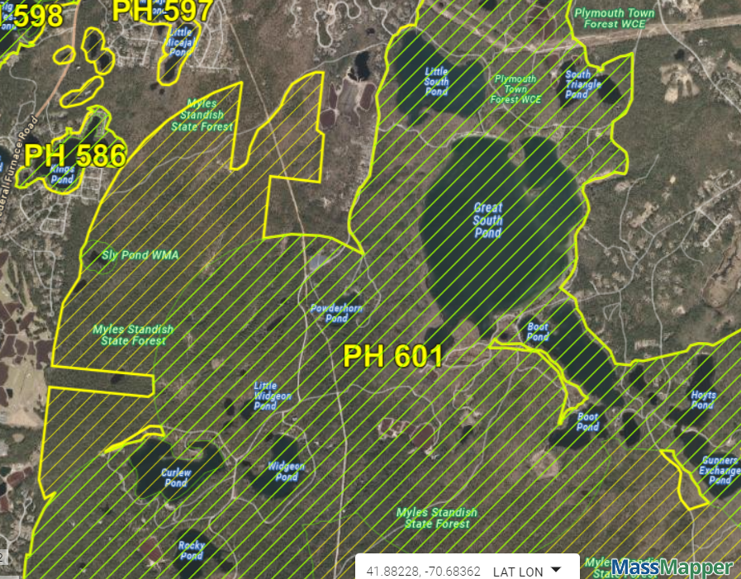
Estimated Habitat & Priority Habitat

Slide 23
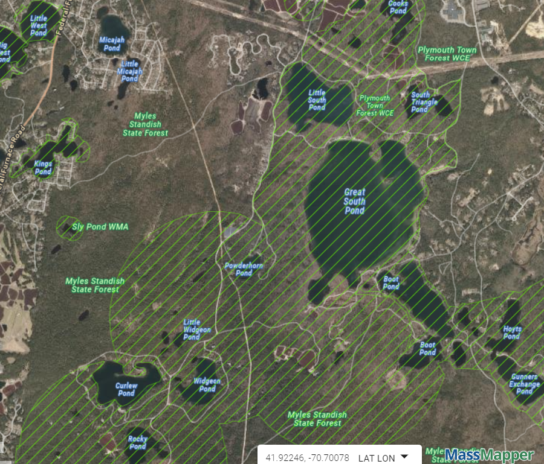
Estimated Habitat

Slide 24
Conservation Commission Wetlands Protection – Endangered Species
If Estimated Habitat:
Copy of NOI to NHESP
NHESP has 30 days to review
NHESP determines whether actual habitat
NHESP decides whether:
Adverse effects (WPA)
Take (MESA)

Slide 25
Questions & Discussion
Luke H. Legere
McGregor Legere & Stevens PC
15 Court Square – Suite 660, Boston, MA 02108
Ph: 617-338-6464 x126
Email: llegere@mcgregorlaw.com
Ryan D. Grondahl
175 Federal Street, Suite 1500, Boston MA 02110
rgrondahl@daintorpy.com

