Slide 1



DRAFTING TRAPS:
HOW TO AVOID & FIX COMMON PROBLEMS ARISING OUT OF DOCUMENT DRAFTING

Slide 2


Trusts
Trustees, Certificates, Fiduciary Powers

Slide 3
What Trustee Certificate should be used?
Trust is not recorded at the registry of deeds
Trustee Certificate pursuant to M.G.L. c. 184, Section 35
REBA Form 35
Trust is recorded at the registry of deeds
REBA Form 20G (Nominee Trusts)
Forms and Templates should be edited to reflect the terms of the Trust

Slide 4

Trustee Certificates – 184/35
  Section 35. Notwithstanding section 25 to the contrary, a certificate sworn to or stated to be executed under the penalties of perjury, and in either case signed by a person who from the records of the registry of deeds or of the registry district of the land court, for the county or district in which real estate owned by a nontestamentary trust lies, appears to be a trustee thereunder and which certifies as to: (a) the identity of the trustees or the beneficiaries thereunder; (b) the authority of the trustees to act with respect to real estate owned by the trust; or (c) the existence or nonexistence of a fact which constitutes a condition precedent to acts by the trustees or which are in any other manner germane to affairs of the trust, shall be binding on all trustees and the trust estate in favor of a purchaser or other person relying in good faith on the certificate. The certificate most recently recorded in the registry of deeds for the county or district in which the real estate lies shall control.

Slide 5
What if there is a problem with the Trustee Certificate Pursuant to M.G.L. c. 184, § 35 that is already on record?
Record a new section 35 certificate executed by the trustee of record.
What if the trustee of record is dead and there are no successor trustees named in the record certificate?
      Review the Trust and determine who the named successor trustee is or how one is appointed.
      Establish the successor trustee of record, See REBA Title Standard 68, by recording:
        the whole Trust
        A trustee certificate executed by the successor trustee or affidavit along with a M.G.L.c. 183 § 5B Affidavit by an attorney or independent person familiar with the affairs of the Trust certifying to appointment of the successor trustee.
        A trustee certificate pursuant to M.G. L. c. 203E, § 1013 executed by the person established to be the successor trustee. The 203E, § 1013 must contain the excerpts of the trust establishing the trusteeship and any required documents must be recorded either attached to or along with the certificate.

Slide 6
What if there is a problem with the Trustee Certificate Pursuant to M.G.L. c. 184, § 35 that is already on record?
Establish the successor trustee of record, See REBA Title Standard 68:
Reference a Probate where the trustee is named in the Will or Decree and Order of Complete Settlement listed as a Devisee in MPC form 163 and Decree and Order of Complete Settlement.
Record a certified copy of a section 35 certificate already recorded in a different registry in the registry where the property lies.
Probate court order appointing the successor trustee.

Slide 7
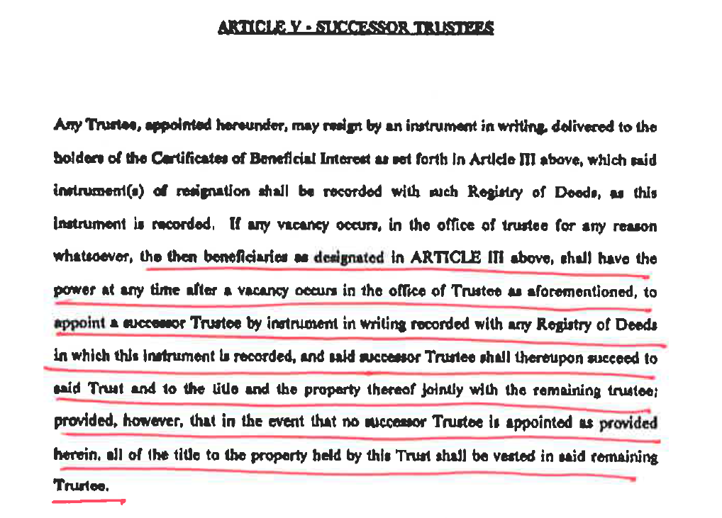
SUCCESSOR TRUSTEES
Appointment by Beneficiary

Slide 8

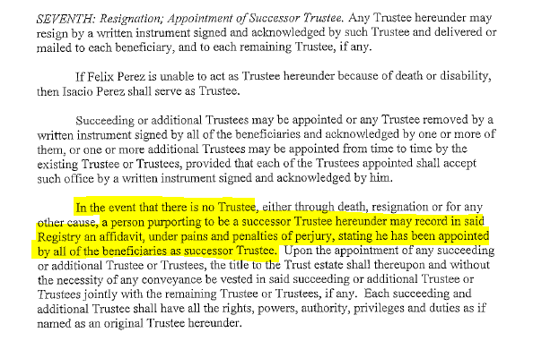
Language that we can rely on anyone purporting to be a successor trustee

Slide 9
TRUST DEEDS: GRANTOR AND GRANTEE CLAUSES
DEEDS INTO TRUSTS SHOULD BE TO THE TRUSTEE:
  BOB BUYER, TRUSTEE OF THE BUYER FAMILY TRUST u/d/t December 3, 2020, see Trust recorded in Book 1234, page 567
  BOB BUYER, TRUSTEE OF THE BUYER FAMILY TRUST u/d/t December 3, 2020, see Trust recorded herewith
  BOB BUYER, TRUSTEE OF THE BUYER FAMILY TRUST u/d/t December 3, 2020, see Certificate of Trust pursuant to M.G.L. ch. 184, section 35 recorded herewith
  COMMON MISTAKES:
  THE BUYER FAMILY TRUST u/d/t December 3, 2020, see Trust recorded in Book 1234, page 567
  Trustee must be named in Grantor and Grantee clauses
  BOB BUYER, TRUSTEE OF THE BUYER FAMILY TRUST u/d/t December 3, 2020
  The Grantee and Grantor clause must contain a reference to recorded trust or Certificate of Trust - M.G.L. ch. 184, section 35.

Slide 10
GRANTOR CLAUSE: DEEDS BY TRUSTEES OF TRUSTS
GRANTOR CLAUSE -RECORDED TRUSTS:
__________________ Trustee of the _________________Trust u/d/t (date of Trust), see Trust recorded in Book ________, page __________
__________________ Trustee of the _________________Trust u/d/t (date of Trust), see Trust recorded herewith
GRANTOR CLAUSE– Unrecorded Trusts:
__________________ Trustee of the _________________Trust u/d/t (date of Trust), see Certificate of Trust pursuant to M.G.L. ch. 184, section 35 recorded in Book ________, page __________
__________________ Trustee of the _________________Trust u/d/t (date of Trust), see Certificate of Trust pursuant to M.G.L. ch. 184, section 35 recorded herewith
GRANTOR CLAUSE Testamentary Trust:
__________, Trustee of the Jane Doe Testamentary Trust, u/d/t contained in the probated will of the Estate of Jane Doe, Probate and Family Court, Docket No.###########, by power conferred under the Trust,

Slide 11
What if there is a problem with the Grantee Clause into a Trust that is already recorded?
    Title Standard 45
    The Trust is a Business Trust that is filed with the Secretary of the Commonwealth.
    There is a reference to recorded 184/35 Certificate or the recorded Trust that names the Trustees
    A testamentary Trust names the Trustee in the duly probated Will/Estate.

Slide 12
What if there is no Trust or 184/35 Trustee Certificate?
Indefinite Reference
Section 25. No indefinite reference in a recorded instrument shall subject any person not an immediate party thereto to any interest in real estate, legal or equitable, nor put any such person on inquiry with respect to such interest, nor be a cloud on or otherwise adversely affect the title of any such person acquiring the real estate under such recorded instrument if he is not otherwise subject to it or on notice of it. An indefinite reference means (1) a recital indicating directly or by implication that real estate may be subject to restrictions, easements, mortgages, encumbrances or other interests not created by instruments recorded in due course, (2) a recital or indication affecting a description of real estate which by excluding generally real estate previously conveyed or by being in general terms of a person's right, title or interest, or for any other reason, can be construed to refer in a manner limiting the real estate described to any interest not created by instruments recorded in due course, (3) a description of a person as trustee or an indication that a person is acting as trustee, unless the instrument containing the description or indication either sets forth the terms of the trust or specifies a recorded instrument which sets forth its terms and the place in the public records where such instrument is recorded, and (4) any other reference to any interest in real estate, unless the instrument containing the reference either creates the interest referred to or specifies a recorded instrument by which the interest is created and the place in the public records where such instrument is recorded. No instrument shall be deemed recorded in due course unless so recorded in the registry of deeds for the county or district in which the real estate affected lies as to be indexed in the grantor index under the name of the owner of record of the real estate affected at the time of the recording. This section shall not apply to a reference to an instrument in a notice or statement permitted by law to be recorded instead of such instrument, nor to a reference to the secured obligation in a mortgage or other instrument appearing of record to be given as security, nor in any proceeding for enforcement of any warranty of title.

Slide 13
How to fix an indefinite reference:
Record the Trust with your conveyance (NOTE: The Trust must have already been in existence at the time of Deed into the Trust)
And record an affidavit identifying the trust instrument as the one referred to in the conveyance, and the affidavit is marginally referenced to the conveyance.
A trustee’s certificate conforming to the requirements of M.G.L. 184, s 35, executed by at least one trustee appearing of record to hold title as such, is recorded or registered in the registry district where the land lies, either contemporaneously with the acquisition of record title by such trustee(s) or at a later time; (REBA Title Standard #53).
OR
IF the Trust is already of record at a different registry/registry district, a 183/5B affidavit may be recorded identifying the place of recording or registration and the affidavit is marginally referenced to the conveyance.

Slide 14
How to fix an indefinite reference:
The title or an interest therein is held by a purchaser, transferee, or other person relying in good faith on a conveyance by such trustee(s) conforming to the provisions of REBA Title Standard No. 33

Slide 15

Trustee Powers, Nominal consideration transfers
Typically, trustees cannot convey property in and out of a trust for $1.00 absent very specific language in the trust
  Gifting language + Self Dealing
  Trustee has the right to amend/terminate without direction
  Trustee has power to act as the “absolute owner” and 3rd party reliance language
  Beneficial Direction, Trustee Certificate certifying to the direction
** To determine if the conveyance is allowable, the trust must be carefully reviewed

Slide 16
SELF DEALING
MUTC -CHAPTER 203E
M.G.L. ch. 203E, Section 1005. Limitation of action against trustee
(a) Unless previously barred by adjudication, consent or limitation, any claim against a trustee for breach of trust shall be barred as to any beneficiary who has received a final account or other statement fully disclosing the matter and showing termination of the trust relationship between the trustee and the beneficiary, unless a proceeding to assert the claim is commenced within 6 months after receipt of the final account or statement. Any claim against a trustee for breach of trust shall be barred in any event and notwithstanding lack of full disclosure, against a trustee who has issued a final account or statement received by the beneficiary and has informed the beneficiary of the location and availability of records for examination by the beneficiary after 3 years. A beneficiary is deemed to have received a final account or statement if, being an adult, it is received by the beneficiary personally or if, being a minor or disabled person, it is received by the beneficiary's representative as described in article 3.
(b) Where a claim is not barred by subsection (a), a beneficiary may not commence a proceeding against a trustee for breach of trust more than 3 years after the date the beneficiary or a representative of the beneficiary knew or reasonably should have known of the existence of a potential claim for breach of trust.
(c) If subsections (a) and (b) do not apply, a judicial proceeding against a trustee for breach of trust must be commenced within 5 years after the first to occur of:
(1) the removal, resignation or death of the trustee;
(2) the termination of the beneficiary's interest in the trust; or
(3) the termination of the trust.

Slide 17
SELF DEALING
MUTC – CHAPTER 203E
Section 1013. Certification of trust
(a) Instead of furnishing a copy of the trust instrument to a person other than a beneficiary, the trustee may furnish to the person a certification of trust containing the following information:
(1) that the trust exists and the date the trust instrument was executed;
(2) the identity of the settlor;
(3) the identity and address of the currently acting trustee;
(4) the powers of the trustee;
(5) the revocability or irrevocability of the trust and the identity of any person holding a power to revoke the trust;
(6) the authority of co-trustees to sign or otherwise authenticate and whether all or less than all are required in order to exercise powers of the trustee;
(7) the trust's taxpayer identification number; and
(8) the manner of taking title to trust property.
(b) A certification of trust may be signed or otherwise authenticated by any trustee.
(c) A certification of trust shall state that the trust has not been revoked, modified or amended in any manner that would cause the representations contained in the certification of trust to be incorrect.

Slide 18
SELF DEALING
MUTC – CHAPTER 203E
(d) A certification of trust need not contain the dispositive terms of a trust.
(e) A recipient of a certification of trust may require the trustee to furnish copies of those excerpts from the original trust instrument and later amendments which designate the trustee and confer upon the trustee the power to act in the pending transaction.
(f) A person who acts in reliance upon a certification of trust without knowledge that the representations contained in the certification are incorrect shall not be liable to any person for so acting and may assume without inquiry the existence of the facts contained in the certification. Knowledge of the terms of the trust may not be inferred solely from the fact that a copy of all or part of the trust instrument is held by the person relying upon the certification.
(g) A person who in good faith enters into a transaction in reliance upon a certification of trust may enforce the transaction against the trust property as if the representations contained in the certification were correct.
(h) A person making a demand for the trust instrument, in addition to a certification of trust or excerpts, shall be liable for damages if the court determines that the person did not act in good faith in demanding the trust instrument.
(i) This section shall not limit the right of a person to obtain a copy of the trust instrument in a judicial proceeding concerning the trust.

Slide 19
SIGNATURE BLOCKS: TRUSTEES OF TRUSTS
____________________________________
Jane Doe, Trustee of the Jane Doe
Irrevocable Trust
____________________________
Jane Doe, Trustee of the Jane Doe
Testamentary Trust

Slide 20
Trustee Notary Clause
COMMONWEALTH OF MASSACHUSETTS
_______________, ss.
On this ________ day of _____________, 20___, before me, the undersigned notary public, ______________ (name of document signer) personally appeared, proved to me through satisfactory evidence of identification, which were ____________________ , to be the person whose name is signed on the preceding or attached document, and acknowledged to me that (he) (she) signed it voluntarily for its stated purpose, and as Trustee for ABC Trust.
[affix or imprint official seal]
, Notary Public
My commission expires:

Slide 21


Death: Title and Transfers
Establishing Title after Death, Powers and Limitations of Personal Respresentatives

Slide 22
DEEDS FROM AN ESTATE
DRAFTING –GRANTOR AND GRANTEE CLAUSES
ACKNOWLEDGEMENT CLAUSES
LIMITATIONS OF POWER OF A PERSONAL REPRESENTATIVE

Slide 23
Grantor Clause of Deeds from Personal Representatives
Fred Flintstone, as Personal Representatives under the Will of Wilma Flintstone, see Essex Probate Court Docket No. ES20P1220EA, under Power of Sale in the Will and every other power
Fred Flintstone, as Personal Representatives of the Estate of Wilma Flintstone, see Essex Probate Court Docket No. ES20P1220EA, pursuant to a Decree of License to Sell

Slide 24
SIGNATURE BLOCKS: PERSONAL REPRESENTATIVES
____________________________
Jane Doe, Personal Representative
of the Estate of John Doe

Slide 25
ACKNOWLEDGEMENTS: MA PERSONAL REPRESENTATIVES OF ESTATES
COMMONWEALTH OF MASSACHUSETTS
_______________, ss.
On this ________ day of _____________, 20___, before me, the undersigned notary public, Jane Doe (name of document signer) personally appeared, proved to me through satisfactory evidence of identification, which were _______________ , to be the person whose name is signed on the preceding or attached document, and acknowledged to me that (he) (she) signed it voluntarily for its stated purpose as Personal Representative of the Estate of John Doe.
[affix or imprint official seal] , Notary Public
My commission expires:

Slide 26
PERSONAL REPRESENTATIVE DEEDS
DEEDS OF DISTRIBUTION:
Does not divest a devisee or heir at law from their inheritance
Does not provide protection from claims of creditors or legatees

Slide 27
Power of Sale
& Self Dealing
Power of sale found in wills, trusts and powers of attorney
The power to sell is not the power to give away, nor is it the power to self-deal
A fiduciary’s deed to herself is voidable by the heirs or devisees (or beneficiaries) (even if for more than FMV), unless the power of attorney or trust document specifically allows for the self dealing or a court has authorized a purchase by the fiduciary
A PR cannot divest a devisees/heirs at law and transfer the property for less than full consideration.

Slide 28
PERSONAL REPRESENTATIVE DEEDS TO RELATED PARTIES OR LESS THAN FULL CONSIDERATION
The consideration for a deed from a Personal Representative cannot be for nominal consideration.
The grantee in a deed from a Personal Representative must be to an arm’s length third party:
(231/2) sell, lease or encumber to an arm's length third party any real estate of the estate, or an interest in that real estate, for cash, credit or for part cash and part credit, with or without security for unpaid balances and whether the personal representative has been appointed formally or informally; the sale, lease or encumbrance shall be conclusive notwithstanding section 3–302 or any contest of the informal probate proceeding, provided that: (i) if the decedent died without a will, a license has been issued under chapter 202; or (ii) if the decedent died with a will, either: (a) the will, probated formally or informally, empowered the personal representative to sell, lease or encumber that real estate or an interest in that real estate, or (b) a license has been issued under chapter 202.

Slide 29
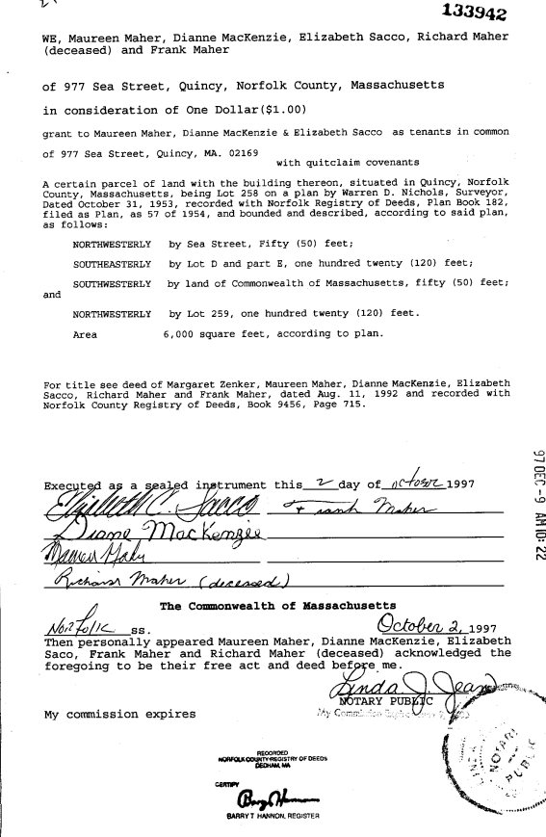

Slide 30



3
Divorce: Title Considerations
Separation Agreements, Divorce Decree, Drafting Considerations

Slide 31
Deeds arising from Divorce Proceeding
Probate Rule 411- Automatic Restraining Order – REBA Title Standard #81
A title derived from a deed from both parties to a divorce action subject to Supplemental Probate Court Rule 411 - Automatic Restraining Order is not on that account defective provided that the deed is executed and acknowledged by both parties. Comment
1. A deed executed and acknowledged by both parties to a divorce action satisfies Section (1) (e) of the Rule (Written agreement of both parties).
2. The automatic restraining order provided for under Rule 411 is automatically vacated upon the entry of a judgment of divorce or separate support.
Caveat This standard is not intended to address issues arising from the distribution of sale proceeds, whether pursuant to order of court, by agreement of the parties or otherwise. Unless the Purchase and Sale Agreement executed by both sellers specifies an unequal distribution of sale proceeds, a single check or EFT to both sellers, as joint payees, should constitute satisfactory discharge of the conveyancer’s obligation acting as settlement agent.

Slide 32
Deed Indexing Standard 12
12-1. Divorce and Deeds Excise Tax – (NEW) A deed that conveys an interest in real estate from one spouse to another for consideration is not subject to the deeds excise tax if the deed specifically states that the amount paid is a division of marital assets pursuant to the divorce and lists the court and docket number of the divorce case.
12-2. Divorce Decree: Transfer of Title – (Appendix C) The recording of a duly certified copy of a divorce decree in the registry of deeds of the district where said real estate is situated, shall have the same force and effect as if a duly executed deed, conveyance or release had so been recorded. For example, if a decree of divorce orders the conveyance of real property, a certified copy of the divorce decree may be recorded in lieu of a deed. The recording fee for the divorce decree is $75. (MGL c.183, s.44)

Slide 33

AFFIDAVITS
AFFIANTS, PERSONAL KNOWLEDGE, DRAFTING AND JURATS

Slide 34
Affidavits: Pursuant to M.G.L. c. 183, § 5A: Recording of statements relating to title; use as evidence
Section 5A. A statement of a person's married or unmarried status, kinship or lack of kinship, or of the date of his birth or death, which relates or purports to relate to the title to land and is sworn to before any officer authorized by law to administer oaths may be filed for record and shall be recorded in the registry of deeds for the county where the land or any part thereof lies. Any such statement, if so recorded, or a certified copy of the record thereof, in so far as the facts stated therein bear on the title to land, shall be admissible in evidence in support of such title in any court in the commonwealth in proceedings relating to such title.

Slide 35
M.G.L. ch. 183, § 5B: Affidavits relating to title; recording
Section 5B. Subject to section 15 of chapter 184, an affidavit made by a person claiming to have personal knowledge of the facts therein stated and containing a certificate by an attorney at law that the facts stated in the affidavit are relevant to the title to certain land and will be of benefit and assistance in clarifying the chain of title may be filed for record and shall be recorded in the registry of deeds where the land or any part thereof lies.

Slide 36
Affidavits: Pursuant to M.G.L. c. 183, § 5B

Slide 37

5
Deeds
Grantors, Grantees, Descriptions, Notary Clauses

Slide 38
Anatomy of a Deed
Type of Deed
Grantor Clause
Grantee Clause
Consideration
GRANT
Covenants
Property Description
Title Reference
Special Language and Property Address
Signatures
Acknowledgement

Slide 39
Property Descriptions: ALL Deeds
  -Adequate descriptions:
    Reference to a lot on a plan.
    Specific description that describes the whole parcel or land to be conveyed. It cannot be described as part of land without specific description of the location.

Slide 40
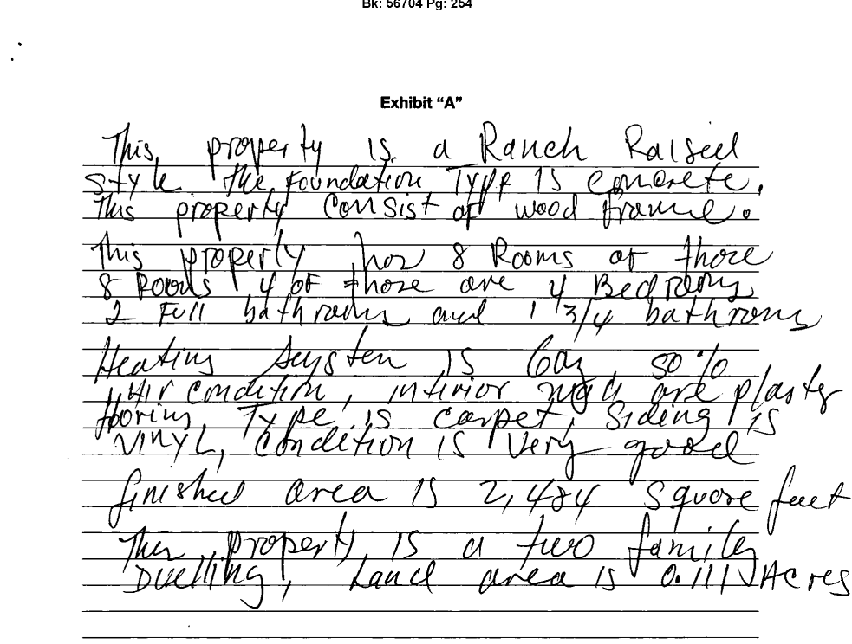

Slide 41
TITLE REFERENCES: ALL Deeds
  Required for recording.
  Title references allow errors in descriptions to be cured by reference to a previously recorded deed with correct description.
  Title reference clauses include:
      “Being the same premises conveyed by….”
      “For grantor’s title see….”

Slide 42

CONVEYANCES BY
CORPORATION’S
Corporation itself is entity.
Grant clause always corporation (not officer)
President/vice president and treasurer/assistant treasurer must sign (G.L.c. 155, § 8)
  If not, then need Vote or Clerk’s Certificate giving authority to individual who is signing the deed
No Land Court guideline on corporations
Must include corporate excise release language or need to have waiver from DOR (T.S. 17)

Slide 43

CONVEYANCES
CORPORATIONS- STATUTE
Chapter 155 of the General Laws is the general corporation statute.
G.L.c. 155, § 8 provides as follows:
A corporation may convey land to which it has a legal title. Any recordable instrument purporting to affect an interest in real estate, executed in the name of a corporation by the president or a vice president and the treasurer or an assistant treasurer, who may be one and the same person, shall be binding on the corporation in favor of a purchaser or other person relying in good faith on such instrument notwithstanding inconsistent provisions of the articles of organization, certificate of incorporation, charter, special act of incorporation, constitution, by-laws, resolutions or votes of the corporation. The provisions of this section shall apply to foreign corporations, as defined in section one of chapter one hundred and eighty- one, as well as to corporations included within section one of this chapter. (Emphasis added.)

Slide 44
Transfers by Limited Liability
Companies
Grant clause is the LLC not the manager
Any Manager or LLC can designate authorized person to sign documents related to real property (G.L.c. 156C, § 12)
If Registered Land, must record a Certificate of Good Standing (dated within 60 days of closing)
LLC is subject to corporate excise tax (G.L.c. 156D, § 1.40 and also see T.S. 17)

Slide 45

Corporate Excise Release Language
Language to be included in transfer:
·the grantor is not classified for the current tax year as a corporation for federal income tax purposes; or
· the conveyance does not constitute the sale or transfer all of substantially all of the grantor’s assets within the Commonwealth of Massachusetts; or
·the conveyance does constitute a sale or transfer in the ordinary course of the grantor’s business.
Without this language a waiver of lien is required from DOR (otherwise land is not free of automatic corporate excise tax lien imposed in Massachusetts for 3 years – see G.L.c. 63, §30)

Slide 46

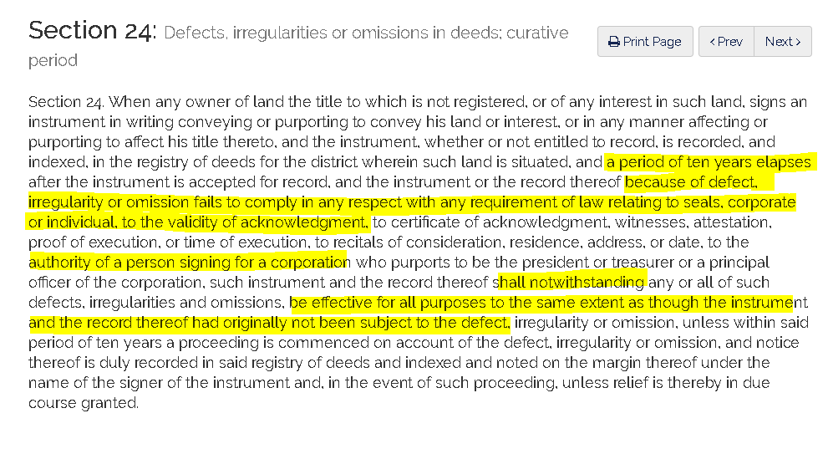
CONVEYANCES
CURATIVE STATUTE
M.G.L.c 184, § 24

Slide 47

TRAPS FOR THE UNWARY

Slide 48

Scrutinize any Foreign Notary Provisions –
Example California Notary
A Notary Public or other officer completing this certificate verifies only the identity of the individual who signed the document to which this certificate is attached, and not the truthfulness, accuracy, or validity of that document.
Massachusetts:
On this 1st day of January, 2020, before me, the undersigned notary public, personally appeared Charles Smith (name of document signer), proved to me through satisfactory evidence of identification, which were _______________________, to be the person whose name is signed on the preceding or attached document, and acknowledged to me that (he) (she) signed it voluntarily for its stated purpose.
On 1/1/2020 before me, Julianne Jones, personally appeared Charles Smith who provided to me on the basis of satisfactory evidence to the be person(s) whose name(s) is/are subscribed to the within instrument and acknowledged to me that he/she/they executed the same in his/her/their authorized capacity(ies) and that his/her/their signature(s) on the instrument the person(s), or the entity upon behalf of which the person(s) acted, executed the instrument.

Slide 49

Fractional Interests
Make sure they add up to 100, otherwise the Grantor will be retaining an interest.
If you are deeding all your interest do not put the percentage interest in the grant clause. If you do put it in make sure it is clear you are are deeding all of your ¼ interest and not ¼ of your ¼ interest.

Slide 50

LAND COURT MEMORANDUM
Accordingly, acknowledged documents used in connection with the conveyance of registered land in Massachusetts – whether notarized within the Commonwealth of Massachusetts or another state – must use a form of acknowledgment that conforms substantially with the statutory form language set forth in c. 222 § 15(b), which includes an acknowledgment that the document was signed voluntarily for its stated purpose.

Slide 51
LAND COURT GUIDELINES AND MEMOS
Land Court Memo Re: Land Court Guideline 14. death: the effect upon registered land titles
Land Court Guideline on LLC
Land Court Requirement: dates
Land Court Memo: acknowledgments and powers of attorney

Slide 52

Signatures
  All grantors must sign.
    Trustees -governed by trust as to number of trustees required to sign.
    LLC Deeds- by the Manager or Person Authorized to sign real estate documents as listed on the Secretary of the Commonwealth certificate of registration or by delegation as provided for by Manager Certificate certifying to vote authorizing the signatory. The Manager’s Certificate to be recorded along with deed. M.G.L. c. 156C, § 24(c)(d), M.G.L. c. 156C, §66
    Deeds by corporations may be signed by The President or Vice President AND Treasurer or Assistant Treasurer or by delegation to any other corporate officer with a Corporate Secretary Certificate of action taken at a Board of Director’s meeting in which it was voted to authorize the signatory (by name or office) to so act. The Secretary Certificate to be recorded along with the deed. See M.G.L. c. 156B, § 115 and M.G.L. c. 156D, §8.46

Slide 53
Registered Land Execution Date Requirement
Date must be inserted immediately before, or next to, the Grantor’s signature
This applies to both Deeds and Mortgages

Slide 54
LAND COURT MEMO FORM OF ACKNOWLEDGMENTS AND POWERS OF ATTORNEY
II. Guidance with regard to powers of attorney used in connection with registered land
DOCUMENTS THAT REQUIRE AN ACKNOWLEDGMENT:
  The Power of Attorney Must conform substantially with statutory form language set forth in c. 222, § 15 (b):
  Satisfactory evidence of identification
  Acknowledgment document was signed voluntarily for its stated purpose
  Document being signed that require an acknowledgment such as Deeds and Mortgages
DOCUMENTS THAT DO NOT REQUIRE AN ACKNOWLEDGMENT:
  Power of Attorney used in connection with the registration of a document that does not require an acknowledgment does NOT require that the POA have a Massachusetts statutory form acknowledgment.
  Documents being signed that do not require an acknowledgment would include Affidavits

Slide 55
Special Language
  Homestead language, see REBA Form 64
  Corporate excise tax release language for Corporations and other business entities, see REBA TS 17
  Non-profit corporation, see REBA TS 66
  Deeds arising out of Divorce Proceedings

Slide 56

REBA Forms
    Form No. 19 – Quitclaim Deed
    Form No. 22 - Residential Condominium Unit Deed

Slide 57

DRAFTING ERRORS
CURATIVE STATUTES

Slide 58
CORPORATE CONVEYANCES
AUTHORITY – DISCHARGES & FORECLOSURES
M.G.L. Chapter 183
Section 54B: Mortgage discharge, release, assignment, foreclosure, etc.; execution before officer entitled to acknowledge instruments; effect
Notwithstanding any law to the contrary, (1) a discharge of mortgage; (2) a release, partial release or assignment of mortgage; (3) an instrument of subordination, non-disturbance, recognition, or attornment by the holder of a mortgage; (4) any instrument for the purpose of foreclosing a mortgage and conveying the title resulting therefrom, including but not limited to notices, deeds, affidavits, certificates, votes, assignments of bids, confirmatory instruments and agreements of sale; or (5) a power of attorney given for that purpose or for the purpose of servicing a mortgage, and in either case, any instrument executed by the attorney-in-fact pursuant to such power, if executed before a notary public, justice of the peace or other officer entitled by law to acknowledge instruments, whether executed within or without the commonwealth, by a person purporting to hold the position of president, vice president, treasurer, clerk, secretary, cashier, loan representative, principal, investment, mortgage or other officer, agent, asset manager, or other similar office or position, including assistant to any such office or position, of the entity holding such mortgage, or otherwise purporting to be an authorized signatory for such entity, or acting under such power of attorney on behalf of such entity, acting in its own capacity or as a general partner or co-venturer of the entity holding such mortgage, shall be binding upon such entity and shall be entitled to be recorded, and no vote of the entity affirming such authority shall be required to permit recording.

Slide 59
Guidance resources
REBA TITLE STANDARDS (“TS”) AND FORMS:
FORMS:
FORM 19: QUITCLAIM DEED
FORM 22: RESIDENTIAL CONDOMINIUM UNIT DEED
FORM 64: TERMINATION OF HOMESTEAD BY STATEMENT MADE IN DEED
Business Entities:
Ts 9: business trusts
ts 11: cORPORATE TRANSFERS
ts 12: fOREIGN COrPORATIONS
TS 17: CORPORATE TAX LIENS
ts 66: transfers by non-profit corporations
TS 75: corporate transfers after dissolution
TS 59: Limited liability company transfers
ts 26: lIMITED PARTNERSHIP TRANSFERS
ts 37: GENERAL PARTNERSHIP TRANSFERS
ts 60: limited liabitly partnership transfers

Slide 60
Guidance resources
Fiduciaries:
Ts 10: Executor’s power of sale
TS 78: PERSONAL REPRESENTATIVE CONVEYANCES PER POWER OF SALE UNDER MASSACHUSETTS UNIFORM PROBATE CODE
Ts 14: missing probates
ts 36: probate inventories
TS 40: transfers by devisees
TS 41: list of heirs
TS 3: federal estate tax liens
TS 24: Massachusetts estate tax liens
TS 13: massachusetts inheritance tax liens
ts 61: massachusetts estate tax liens with respect to transfers for inadequate consideration
FORM 32: eSTATE TAX AFFIDAVIT

Slide 61
Guidance resources
TS 23: self-dealing by trustee
Ts 33: transfer by trustee
ts 45: transfers to trusts
ts 53: indefinite references-trusts
ts 68: trustee certificate under M.G.L. c. 184, s 35
FORM 35: TRUSTEE’S CERTIFICATE PURSUANT TO M.G.L. C. 184, section 35
FORM 20G: RECORDED TRUSTS,
FORM 20H: CERTIFICATE AND DIRECTION OF BENEFICIARY
FORM 20F: NOMINEE TRUSTEE CERTIFICATE OF APPOINTMENT OF SUCCESSOR TRUSTEE AND ACCEPTANCE
FORM 20C: NOMINEE TRUST RESIGNATION
ts 34: powers of attorney
FORM 1: aFFIDAVIT REGARDING POWER OF ATTORNEY
FORM 10: GENERAL POWER OF ATTORNEY FOR REPRESENTING SELLER AT CLOSING
FORM 11: LIMITED POWER OF ATTORNEY FOR REPRESENTING SELLER AT CLOSING
FORM 28: BUYERS LIMITED POWER OF ATTORNEY
Form 36: notary public – acknowledgement
form 37: notary public- jurat

Slide 62
Guidance resources
Land court guidelines (“GL”) and memos:
https://www.mass.gov/doc/land-court-guidelines-on-registered-land/download
https://www.mass.gov/memorandum/form-of-acknowledgments-and-powers-of-attorney
https://www.mass.gov/doc/land-court-chief-title-examiner-memorandum-re-land-court-guideline-14-death-the-effect-of-death/download
Deed Indexing standards
https://www.sec.state.ma.us/divisions/registry-of-deeds/download/index-standards-2018.pdf

Slide 63
Contact Information for Presenters
Lynne Murphy Breen, Esq. – Vice President and Senior Underwriter and Agency Counsel in the Boston Office of Chicago Title and Commonwealth Land Title Insurance Companies. She also serves as the Director of ClearTitle services for the Fidelity National Family of Underwriters.
(617) 790-2114 or lynne.murphy@fnf.com
Scott J. Clifford, Esq. – Managing Partner at the Law Offices of Lispey & Clifford, P.C. His practice mainly focuses on representing buyers, sellers and lenders in residential and commercial transactions. He also has extensive litigation experience that includes the clearing of title issues in the Land Court and Superior Courts throughout Massachusetts.
(781) 829-9100 or sclifford@elclaw.com

