Slide 1
Technology Systems
Policies and Procedures to Protect you, your Office and your Data
REBA’s Residential Conveyancing Section – Open Luncheon
Wednesday February 27th, 2019 at 12pm
REBA Boston

Slide 2
Infrastructure Upgrade & Maintenance
3-5 year Schedule
Monthly Maintenance
Anti-Virus, Malware
Software updates

Slide 3
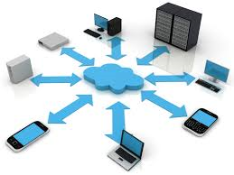
Infrastructure Upgrade & Maintenance
OS patches and upgrade
Java, flash, adobe are security concerns
Remote monitoring
Firewall monitoring
Prevent DoS Attacks!

Slide 4
Disaster Planning and Recovery
Business Continuity
Mitigating Downtime
When Disaster Strikes!
Preparation is KEY!
Have a Plan!

Slide 5
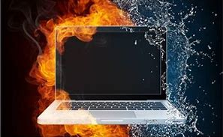
Disaster Planning and Recovery
Backing up data daily using two independent systems. Typically:
Nightly online backup
Local onsite backup of the system image to a portable hard drive (Rotate Offsite)
Perform a test restore from the backup media each month (Make sure it works!)

Slide 6
Information Security
Protecting NPPI
201 CMR 17.0 (WISP)
Notice of Breach Law
93H (Duty to Report)
Proper Disposal

Slide 7
Information Security
Clean desk policy?
Limiting access to scan solution?
All cabinet files locked?
Mobile devices secure?
Control over flash drives?

Slide 8
Information Security
NPPI training?
Using encryption?
Background checks on employees?

Slide 9
Cybercrime Hygiene Damage costs to hit $6 Trillion annually by 2021
Dark Web Evolution
Ransomware
Wire Fraud
Phishing Scams
Mules
Key Loggers

Slide 10
Cybercrime Hygiene
Use strong Passwords
Use domain name email
Encrypt NPPI
Email security (Forward)
Wiring protocol
Funds transfer agreement
Use a log with all parties

Slide 11
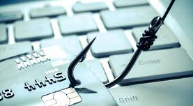
Cybercrime Hygiene
Business Email Compromise (BEC) protocol – training
Beware of FREE WIFI when using firm mobile devices.
Beware of FREE Charging stations (“Video” and “Juice” Jacking)
Consider Cyber Privacy and Media Liability Insurance.

Slide 12
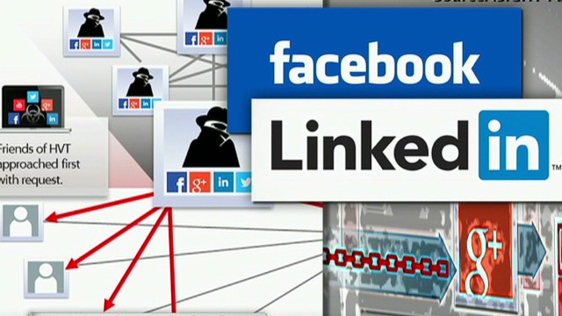
Protection in the Digital Age
Social media concerns
Like-jacking - Beware of fake “Like” buttons on web pages. Malware threat!
Link-jacking - You click on a link and get re-directed to a malware infested site.
Social Phishing – A link disguised in a seemingly trustworthy Facebook message or Tweet. (Usernames, passwords and credit card #’s at risk)
LinkedIn – Gather info to use on phishing attempts. Don’t share too much!

Slide 13
Protection in the Digital Age
IoT Concerns in the Office
“Internet of Things”
“Alexa” in the Office
Cameras
Lighting
Locks
Thermostats
Security concerns

Slide 14
THANK YOU!
Jim Sifflard
SVP, NE Sales Manager
Old Republic Title Insurance
Andrew Rosenthal
Principal & CEO
ArcLight Technologies
Noel DiCarlo
Partner
Warshaw, DiCarlo & Associates

