Slide 1

What You Need to Know About the New Electronic and Online Notarization Law
Francis J. Nolan
October 3, 2023

Slide 2
Overview
Introduction
The Evolution of the Notarial Act
Electronic Notarization
Remote Online Notarization (RON)
UPL Considerations and Notarial Misconduct
What’s Next?
Q & A/Closing

Slide 3

Introduction
How REBA Learned to Stop Worrying and Love the RON

Slide 4

The Evolution of the Notarial Act
Figuring out how to conduct a closing without actually being with people

Slide 5
The Notarial Act as We Know It
Traditional Notarial Act
  Notary and signatory appear together, in person
    Acknowledgement: signatory confirms that signature was affixed voluntarily and, if applicable, with appropriate authority in representative capacity
    Jurat: signatory signs in front of notary, attests to truthfulness of document’s contents under oath/affirmation
    Satisfactory evidence of identity
      1+ photo ID from federal or state government agency w/signature
      Oath/affirmation of credible witness personally known to both notary and signatory
      Personal knowledge
      Non-citizen: passport or other governmental photo ID w/signature showing individual’s nationality

Slide 6
Notarizing In the Time of COVID
Remote Ink-Signed Notarization (RIN)
  Emergency legislation adopted in 2020 in response to COVID pandemic (Ch. 71 of the Acts of 2020), expired in March 2023
  Notary and signatory can be physically located in different locations within Massachusetts
  Electronic video conferencing used to communicate in real time
    Signatory discloses anyone present with the signer—they must be visible to the notary
    Signatory presents government-issued photo ID and, for real estate documents, second form of ID (e.g. credit card, recent tax bill) to notary via video
    Notary observes signatory’s execution of physical document during video conference
    Signatory sends wet-ink signed document to notary
    Notary conducts second video conference to verify document is the same one signatory executed and to conduct the notarial act
    Notary retains audio/video recording of both video conferences for 10 years
    Real estate: notary must be MA attorney or acting under direct supervision of MA attorney

Slide 7
Chapter 2 of the Acts of 2023
Changes:
  Definitions
  Seal
  Journal
  UPL/Notary Misconduct
  Electronic Notarization
  Remote Notarization
Except for UPL, all changes affect MGL c. 222 – the chapter governing MA notaries public
Effective January 1, 2024
“The RON Bill”

Slide 8

Electronic Notarization
Goodbye briefcase, hello iPad!

Slide 9
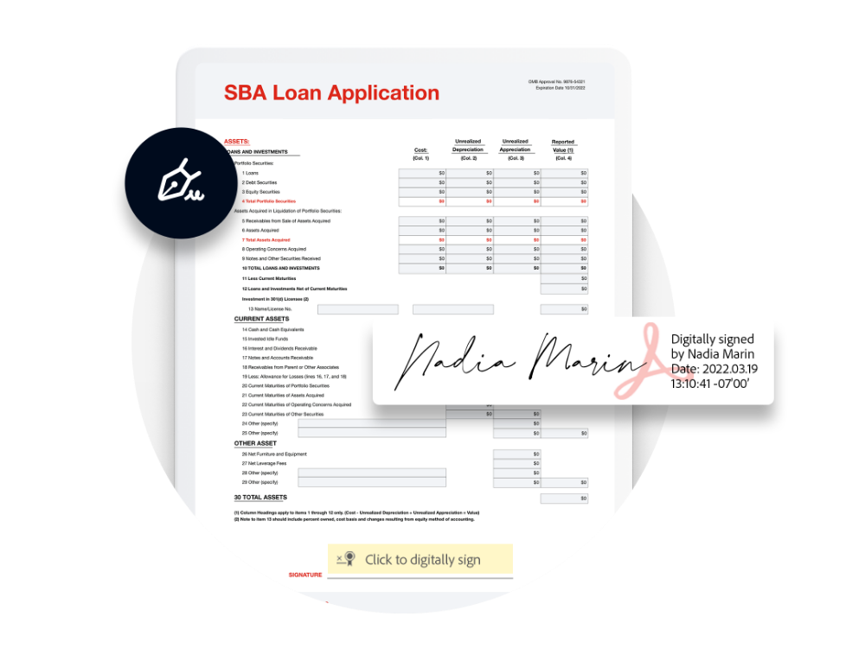
In-Person Electronic Notarization (IPEN)
New statutory section: G.L. c. 222, s. 27
Allows notary to affix an electronic signature and seal to an electronic document
Requires use of tamper-evident technology
  Tamper-evident: a layer of security in electronically notarized documents that provides evidence of any changes made to an electronic document after it was notarized.
    Example: digital certificate
Notary chooses the technology platform
Electronic seal must be
  Unique to the notary
  Independently verifiable
  Retained under notary’s sole control AND
  Attached to or logically associated with the electronic record in tamper-evident manner

Slide 10
Working Backwards: Making an Electronic Record Tangible
For instances in which an electronic document cannot be recorded electronically, statute allows document to be converted into a tangible copy
Tangible copy must satisfy all requirements for recording an original document
Notarial certificate must satisfy all requirements for an original document to be accepted for recording
Notary who executed the notarial certificate must certify that the tangible copy is an accurate copy of the electronic record

Slide 11

Remote Online Notarization
One more thing you can do without ever leaving the house…

Slide 12
Remote Online Notarization (RON)
New statutory section: G.L. c. 222, s. 28
Allows notary to effect a notarial act not just electronically, but remotely
Requires use of communication technology approved by the Secretary of the Commonwealth
Cannot be used to notarize the following:
  Record related to the electoral process
  Will, codicil or document purporting to be a will or codicil
Only available to Massachusetts notaries acting within the Commonwealth of Massachusetts (signatories can be anywhere!)
  Some limitations on notarizing documents when signatory is outside of U.S.

Slide 13
Definitional Changes for RON
“In person” now defined to include “interacting with a remotely-located individual by means of communication technology in compliance with section 28.”
Various other definitions in G.L. c. 222, s. 1 updated to account for electronic as well as tangible documents
Technology definitions specific to RON
  Capable of independent verification (re: electronic seal)
  Communication technology
  Credential analysis
  Dynamic knowledge-based authentication
  Identity proofing
  Remotely-located individual
Satisfactory evidence of identity is different for RON transactions than for in-person transactions

Slide 14
Walk Before You RON
First, you need to be commissioned!
  Register as a remote notary with the Secretary’s office
  Inform the Secretary that you intend to perform remote notarizations
  Identify the communication technology you’re going to use for remote notarizations
  If required by the Secretary, complete a training course
  Provide notice to the Secretary
    Affirming you’ve read and will comply with Section 28 and all rules adopted by the Secretary
    Including proof you’ve completed the Secretary’s training, if required
    Identifying a usual place of business in Massachusetts or, if a foreign entity, a registered agent, and
    Identifying an address for service of process in connection with a civil action or other proceeding

Slide 15
Communication Technology
Critical component of remote online notarization is the use of an approved technology platform
Considerations:
  Ease of use
  Reliability
  Method of identity proofing
  Records retention (who keeps the recordings?)
  Cost and billing structure
  Do you need/want to be part of their “network?”

Slide 16
Steps in the RON Process
Parties sign in to the communication technology platform
  Each party goes through a quick technology check to ensure they have working webcam and microphone and sufficient internet connection
Signatories proceed through at least two identity proofing processes
  Communication technology provides notary with a means of verifying signatory’s identity
Parties review the document(s) to be executed
Signatories affix their electronic signature
Notary affixes electronic signature and seal

Slide 17
Verifying Identity
Process of verifying signer’s identity is significantly more robust than traditional verification methods
Credential analysis: appropriate photo ID presented, communication technology validates through public or proprietary data sources
Dynamic knowledge-based authentication (KBA): communication technology asks signer a series of personal questions drawn from public or proprietary data sources
Analysis of biometric data such as facial recognition, voiceprint analysis or fingerprint analysis
RON communication technology must use at least two of these identity proofing methods in order for the notary to be able to conduct the notarial act

Slide 18
Other RON Requirements
Notary must be able to execute the notarial act in a single real-time session
Notary is responsible for creating an audio-visual recording of the notarial act
  Audio-visual recording must be retained for 10 years
  Communication technology provider may have ability to retain recording for you
Notary must record the act in a tamper-evident electronic journal
  Communication technology provider may have ability to document the act in journal form
  Law allows you to maintain multiple electronic journals
Notary cannot use/sell/offer to sell personal info obtained through a RON transaction
For real estate closings—
  Once the signatory’s identity has been verified, the communication technology platform will require the entry of the BBO number of the MA attorney overseeing the closing
You can pass along the cost of using communication technology

Slide 19

UPL and Notary Misconduct
How to stay on the right side of the practice

Slide 20
Keeping UPL Out of RON Transactions
New statute, G.L. c. 221, s. 46E, largely codifies REBA v. NREIS decision (2011)
Only a MA attorney in good standing can do the following:
  Direct or manage a real estate closing
  Give legal advice as to the legal status of title
  Ensure that the seller/mortgagor is in a position to convey marketable title
  Issue a certification of title
  Draft a deed to real property on behalf of someone else
  Ensure that documents necessary to convey title were properly executed/acknowledged
    Non-attorney can take this step if under the direction/supervision of a MA attorney
  Disburse or manage the disbursement of consideration for the conveyance

Slide 21
Penalties
UPL violation:
  Attorney general can initiate action against “any person or creditor” engaging in pattern or practice of non-compliance
  Private right of action for a person having an interest or right potentially adversely affected
Misconduct by remote notary:
  Secretary has authority to revoke notary commission
  Attorney General has authority to enforce Secretary’s order

Slide 22
What’s Next?
All eyes on Secretary Galvin
  Procedures for obtaining “remote notary” commission
  Rules regarding performance of RON notarial act
  Approval of communication technology providers
  Establishment of standards for identity proofing
Land Court may promulgate rules/guidelines for recording electronic documents with respect to registered land
Registries may need to adopt guidelines for recording electronic documents
  Are there technological limitations in existing registry systems that should be reviewed?

Slide 23
You: Q
Me: A

Slide 24

Thank You!
Contact me:
Fran Nolan
Harmon Law Offices, P.C.
fnolan@harmonlaw.com
(617) 558-8418

